Slide 1


Credit Card Fraud Detection
R Sathiya Suriya
Manisha Bagri
Bibek Kumar Gupta

Slide 2


Agenda
Problem Statement
Objective
Data Set
Procedure
EDA
Model selection
Final Model
Cost benefit analysis
Dashboard
Conclusion

Slide 3
Problem Statement
Credit card fraud is an inclusive term for fraud that is committed using a payment card, such as a credit card or a debit card, by stealing the card information through skimmers.
The Federal Trade Commission (US) has estimated that around 10 million people become victims of credit card theft each year. Credit card companies lose close to $50 billion per year to fraud.

Slide 4
Objective
Finex is a leading financial service provider based out of Florida, US. It offers a wide range of products and business services to customers through different channels, ranging from in-person banking and ATMs to online banking.
Finex has observed that a significantly large number of unauthorized transactions are being made, due to which the bank has been facing a huge revenue and profitability crisis.
Our task is to identify the root cause and recommend ways to mitigate this problem

Slide 5
DATASET
The training dataset has 12,96,675 rows and 22 columns
The target variable is the column - is_fraud.
There are no null values in the training data set
There are no duplicate datas available.

Slide 6
Procedure followed
Data Preparation:
1. checking for null values
2. checking for duplicate columns
3. Handling outliers
4. Univariate analysis
5. Correlation
6. Dummy variables
7. Handling class imbalance
8. Repeating the above mentioned steps for test data
Model Building
Model Selection
Cost-Benefit Analysis
Observations and conclusion

Slide 7
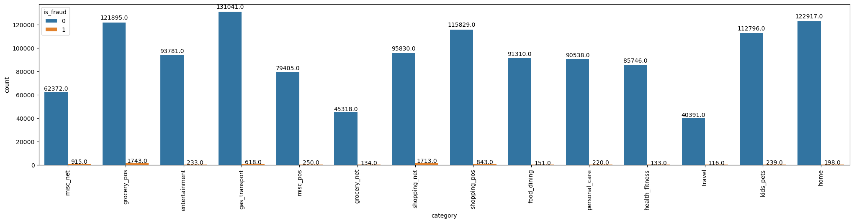
EDA – Univariate Analysis- Category
Observations:
1. The highest no of fraudulent transactions have occurred in the categories grocery_pos and shopping_net
2. The least no of fraudulent transactions have occurred in the categories travel and health_fitness.
3. Huge volume of transactions have occurred under the category gas_tranport

Slide 8
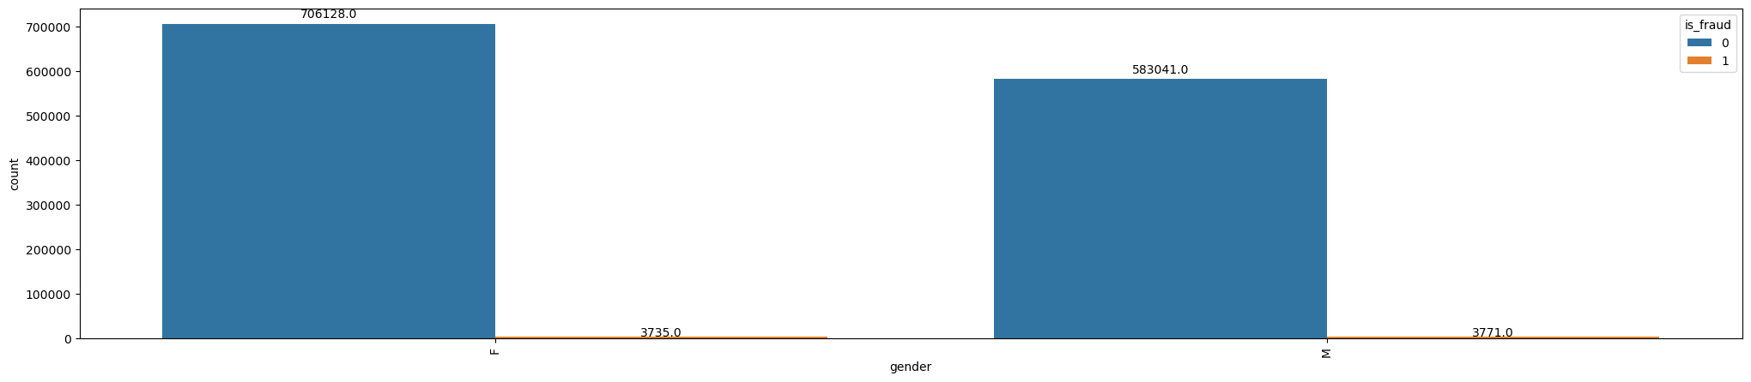
EDA – Univariate Analysis- Gender
Observations:
1. Female gender has higher no of transactions compared to male
2. The no. of fraudulent transactions are almost similar for both the gender irrespective of the volume of transactions

Slide 9
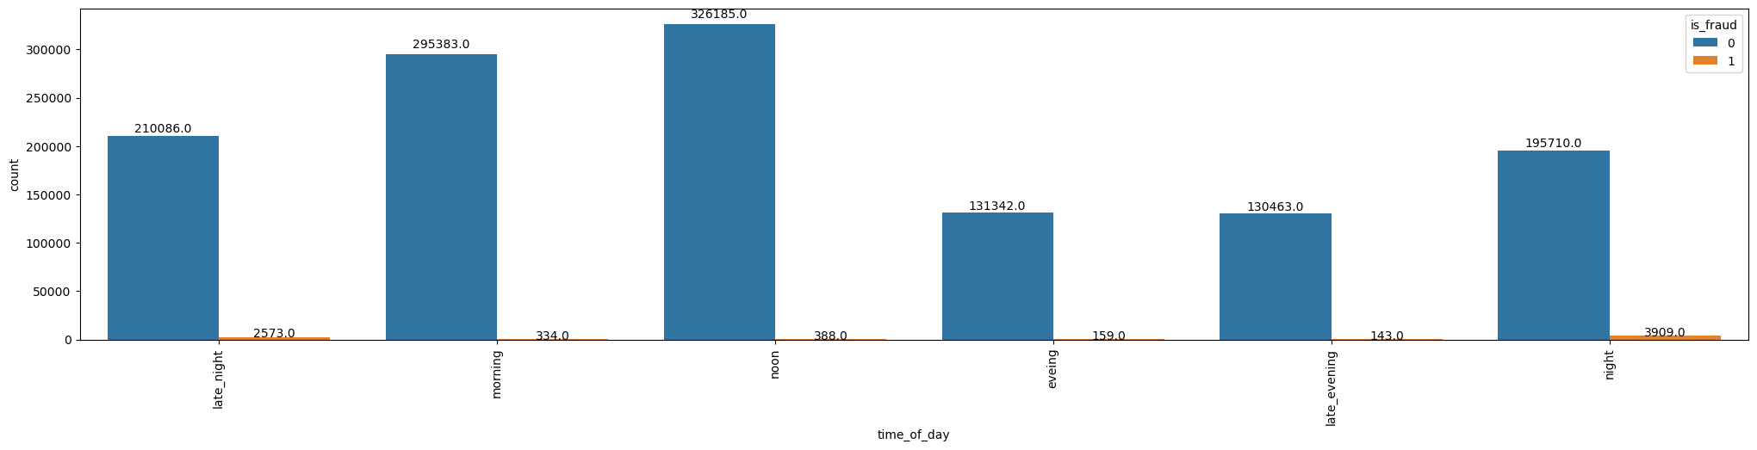
EDA – Univariate Analysis- Time of Day
Observations:
1. Night and Midnight have highest no of fraudulent transaction irrespective of huge volume of transactions taking place during noon
2. Morning and noon have the highest volume of transactions

Slide 10
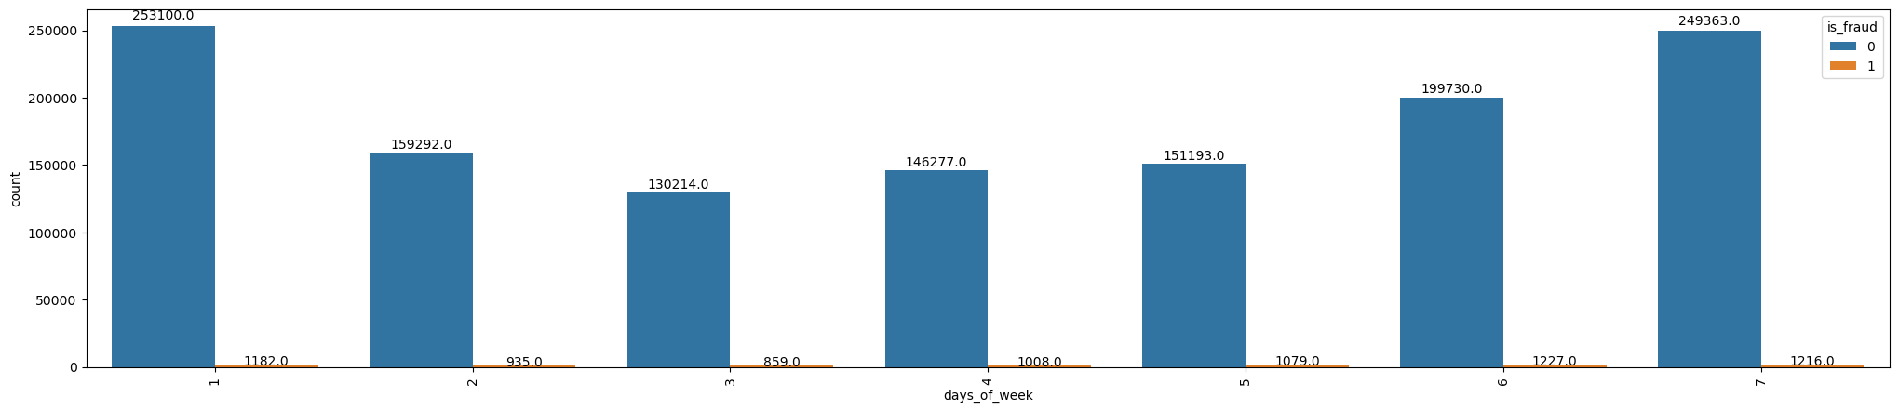
EDA – Univariate Analysis- Days of Week
Observtions:
1. The no of fraudulent transaction remain almost similar irrespective of the days of the week
2. Sunday and Monday have the highest volume of transactions

Slide 11
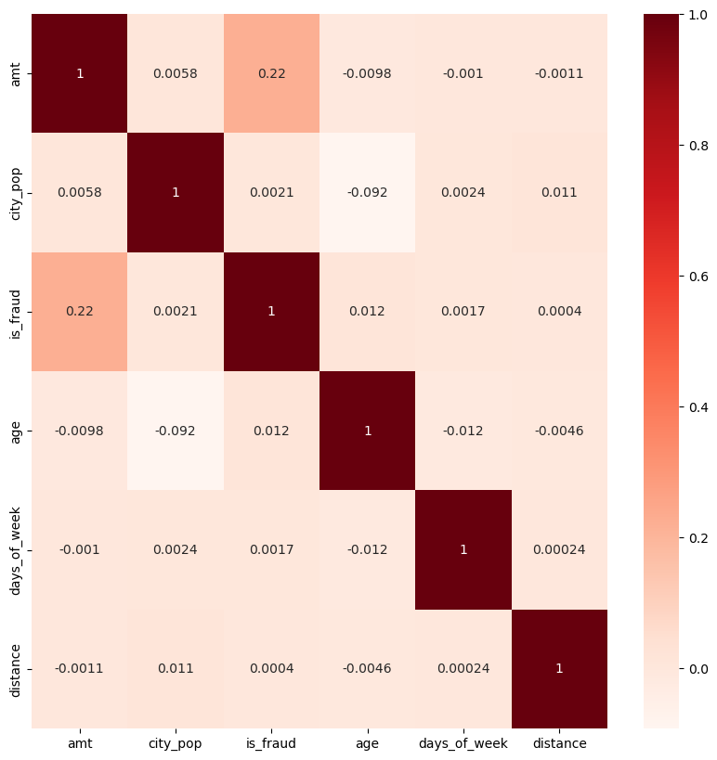
Correlation
Observations:
1. The target variable is_fraud and amt have the highest correlation of 0.22

Slide 12
Model Selection
Models used:
Decision tree
Random Forest
XG Boost
Important variables/ characteristics are:
Amount
Category – shopping net
Time – morning, night and noon

Slide 13
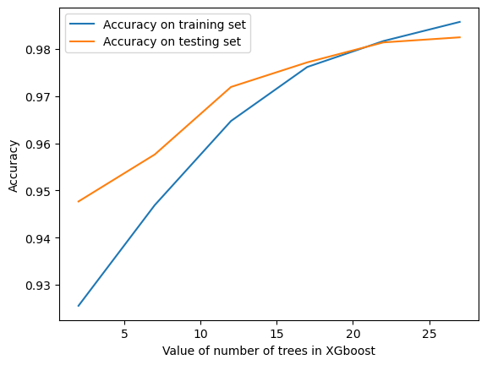
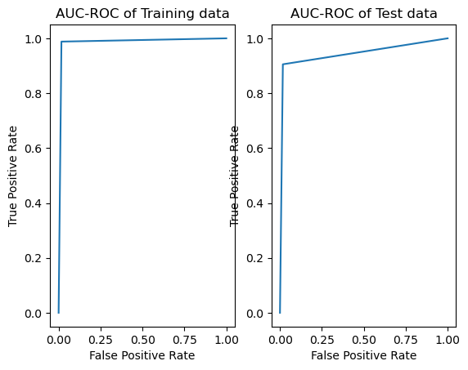
Final Model
Final Model – XG Boost with oversampled ADASYN Data with 26 estimators
Performance:
the accuracy of the training set is 98.56%
the accuracy of Test set is 98.25%
The recall of training set is 0.98
The recall of test set is 0.90
The AOC-ROC of training set is 0.98
The AOC-ROC of test set is 0.94

Slide 14
Cost Benefit Analysis
Average No. of Transaction Per month = 77,183
Average No of Fraudulent Transaction Per month = 402
Average amount per fraudulent transaction = $530
Cost Incurred per month now = $2,13,060
Average no of transactions detected by our model per month = 1701
Cost paid for providing customer support = $1.5 per transaction
Total cost paid to customer support = $ 2,551.5
Average no of fraudulent transactions not detected by our model = 111
Cost incurred due to undetected fraudulent transaction by our model = $58,830
Total Cost incurred after deploying our model = $61,381.5
Total Savings due to deploying our model = $213060 - $61381.5 = $1,51,678.5

Slide 15
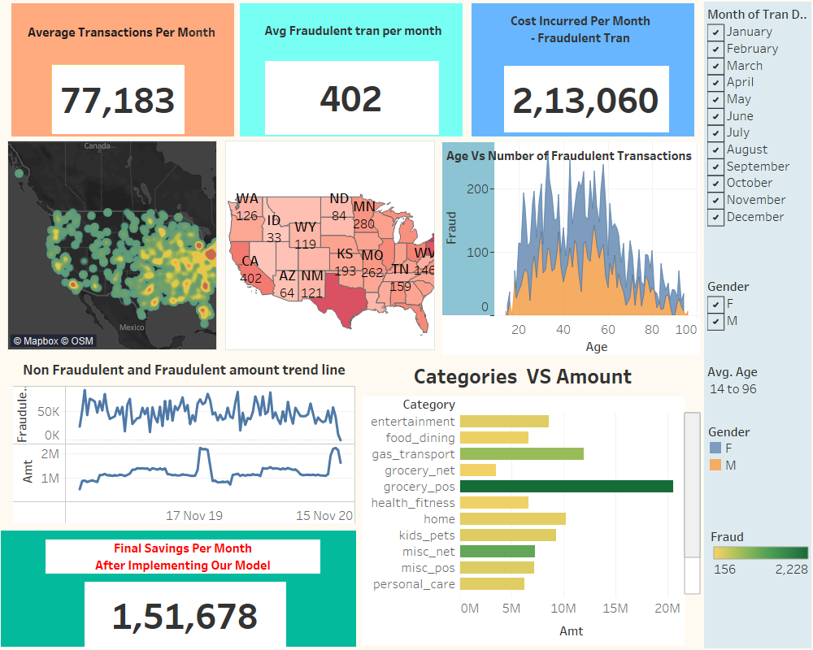
Dashboard
Link: https://public.tableau.com/views/project_credit_card_fraud/Dashboard1?:language=en-US&publish=yes&:display_count=n&:origin=viz_share_link

Slide 16
Conclusion
The best selected model has a accuracy of 98.25% and recall of 0.90
In the cost benefit analysis we found that A average amount of $ 1,51,678.5 per month could have been saved if our model was implemented by the bank

